Slide 1


<Name>
<Date>

Slide 2

Outline
Executive Summary
Introduction
Methodology
Results
Conclusion
Appendix

Slide 3
Executive Summary
Summary of methodologies
Data Collection through API
Data Collection with Web Scraping
Data Wrangling
Exploratory Data Analysis with SQL
Exploratory Data Analysis with Data Visualization
Interactive Visual Analytics with Folium
Machine Learning Prediction
Summary of all results
Exploratory Data Analysis result
Interactive analytics in screenshots
Predictive Analytics result

Slide 4
Introduction
Project background and context
SpaceX advertises Falcon 9 rocket launches on its website with a cost of 62 million dollars; other providers cost upward of 165 million dollars each, much of the savings is because SpaceX can reuse the first stage. Therefore if we can determine if the first stage will land, we can determine the cost of a launch. This information can be used if an alternate company wants to bid against space X for a rocket launch. This goal of the project is to create a machine learning pipeline to predict if the first stage will land successfully
Problems you want to find answers
What factors determine if the rocket will land successfully?
The interaction amongst various features that determine the success rate of a successful landing.
What operating conditions needs to be in place to ensure a successful landing program

Slide 5

Section 1

Slide 6
Methodology
Executive Summary
Data collection methodology:
Describe how data was collected
Perform data wrangling
Describe how data was processed
Perform exploratory data analysis (EDA) using visualization and SQL
Perform interactive visual analytics using Folium and Plotly Dash
Perform predictive analysis using classification models
How to build, tune, evaluate classification models

Slide 7
Data Collection
How data sets were collected ?
Request and parse the SpaceX launch data using the GET request
Decode the response content as a Json and turn it into a Pandas dataframe
Use the API again to get information about the launches using the IDs given for each launch
Construct our dataset using the data we have obtained. We we combine the columns into a dictionary.
Then, create a Pandas data frame from the dictionary

Slide 8
Data Collection – SpaceX API
Request & Parse the Data
Decode the response
Store in Pandas Dataframe
Use the API to get information using the IDs
Construct dataset
Combine the data in Dictionary
Create a pandas dataframe from dictionary
The link to the notebook is https://github.com/erwinzn/coursera/blob/ee9198a4b0196119f2060b0effe7159966accabc/jupyter-labs-spacex-data-collection-api.ipynb

Slide 9
Data Collection - Scraping
Request the Falcon9 Launch HTML page
Create a BeautifulSoup object
Extract all column/variable names from the HTML table header
Create a data frame by parsing the launch HTML tables
Construct dataset
Combine the data in Dictionary
Create a pandas dataframe from dictionary
We applied web scrapping to webscrap Falcon 9 launch records with BeautifulSoup
We parsed the table and converted it into a pandas dataframe.
The link to the notebook is https://github.com/erwinzn/coursera/blob/4fa82c990135b12797286beeb190108f3c996a25/jupyter-labs-webscraping.ipynb

Slide 10
Data Wrangling
Load Space X dataset to pandas dataframe
Identify and calculate the percentage of the missing values in each attribute
Calculate the number of launches and outcome
Create a landing outcome label from Outcome colum
Flowcharts of data wrangling
The link to the notebook is https://github.com/erwinzn/coursera/blob/3f08549fd9c06d1fadd18e5417060836805cdd9c/labs-jupyter-spacex-Data%20wrangling.ipynb

Slide 11
EDA with Data Visualization
Charts that we used :
Scatter Plot to show the relationship between two variables
Bar chart to find the success rate
Line chart to observe the trend
The link to the notebook is https://github.com/erwinzn/coursera/blob/927cacb563fdeb4b79fb92e72c0c82c83377c330/jupyter-labs-eda-dataviz.ipynb

Slide 12
EDA with SQL
The SQL queries that I performed
SELECT Distinct LAUNCH_SITE FROM SPACEXTBL
SELECT * FROM SPACEXTBL WHERE LAUNCH_SITE LIKE 'CCA%' LIMIT 5
SELECT SUM(PAYLOAD_MASS__KG_) FROM SPACEXTBL WHERE CUSTOMER='NASA (CRS)’
SELECT AVG(PAYLOAD_MASS__KG_) FROM SPACEXTBL WHERE BOOSTER_VERSION='F9 v1.1’
SELECT min(DATE) FROM SPACEXTBL WHERE LANDING__OUTCOME='Success (ground pad)’
SELECT BOOSTER_VERSION FROM SPACEXTBL WHERE PAYLOAD_MASS__KG_ between 4000 and 6000 AND LANDING__OUTCOME='Success (drone ship)’
SELECT COUNT(*) FROM SPACEXTBL WHERE MISSION_OUTCOME LIKE '%Success%' OR MISSION_OUTCOME LIKE '%Failure%'
Add the GitHub URL of your completed EDA with SQL notebook, as an external reference and peer-review purpose

Slide 13
EDA with SQL
The SQL queries that I performed
SELECT BOOSTER_VERSION FROM SPACEXTBL WHERE PAYLOAD_MASS__KG_ = (SELECT MAX(PAYLOAD_MASS__KG_) FROM SPACEXTBL)
SELECT TO_CHAR(TO_DATE(MONTH("DATE"), 'MM'), 'MONTH') AS MONTH_NAME, LANDING__OUTCOME AS LANDING__OUTCOME, BOOSTER_VERSION AS BOOSTER_VERSION, LAUNCH_SITE AS LAUNCH_SITE FROM SPACEXTBL WHERE LANDING__OUTCOME = 'Failure (drone ship)' AND "DATE" LIKE '%2015%’
SELECT "DATE", COUNT(LANDING__OUTCOME) as COUNT FROM SPACEXTBL WHERE "DATE" BETWEEN '2010-06-04' and '2017-03-20' AND LANDING__OUTCOME LIKE '%Success%’ GROUP BY "DATE“ ORDER BY COUNT(LANDING__OUTCOME) DESC
The link to the notebook is https://github.com/erwinzn/coursera/blob/726de67ee35612838402268e330ac7a81b54bd3e/jupyter-labs-eda-sql-coursera-Copy1.ipynb

Slide 14
Build an Interactive Map with Folium
Objects such as markers, circles, lines, etc. that we created and added to a folium map
We marked all launch sites and added map objects such as markers and circles for each site on the folium map.
We marked the success/failed launches for each site on the map, to identify which site has high success rate
We draw lines to the closest railway, highway and city to see if there are with in the proximity range
The GitHub URL of completed interactive map with Folium map https://github.com/erwinzn/coursera/blob/2b0464a42e9803546f0f5223d8b3e2de2591bc0e/lab_jupyter_launch_site_location.ipynb

Slide 15
Build a Dashboard with Plotly Dash
Plots/graphs and interactions we have added to a dashboard
Add dropdown for launch site
Add Slider for payload
Add pie chart for total lauch site
Add scatter plot site vs payload
The GitHub URL https://github.com/erwinzn/coursera/blob/688955e6826aa0408bf069565720e2beeea54a0c/main.py

Slide 16
Predictive Analysis (Classification)
How we built, evaluated, improved, and found the best performing classification model
Create a label data
Standardize the data in X
Split the data into train and test set
Fit the data into the model
Find the best performing model
The GitHub URL https://github.com/erwinzn/coursera/blob/a5e3dcb08ece0117331571320ec3dc6b1802d0b2/SpaceX_Machine%20Learning%20Prediction_Part_5.ipynb
Create Y
Standardize X
Split the data into train and test set
Fit the data into the model
Find the best model

Slide 17
Results
Exploratory data analysis results
Space X uses 4 different launch sites;
The average payload of F9 v1.1 booster is 2,928 kg;
The first success landing outcome happened in 2015 fiver year after the first launch;
Many Falcon 9 booster versions were successful at landing in drone ships having payload above the average;
Almost 100% of mission outcomes were successful;
The number of landing outcomes became as better as years passed.

Slide 18
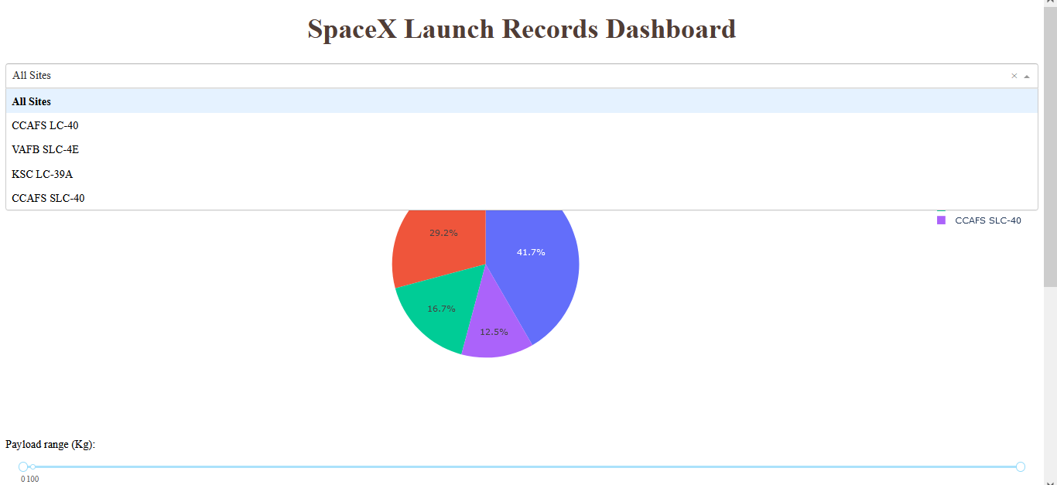
Results
Interactive analytics demo in screenshots

Slide 19
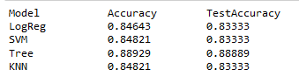
Results
Predictive analysis results
The Best Model for predictive analysis is using the Decision Tree

Slide 20

Section 2

Slide 21
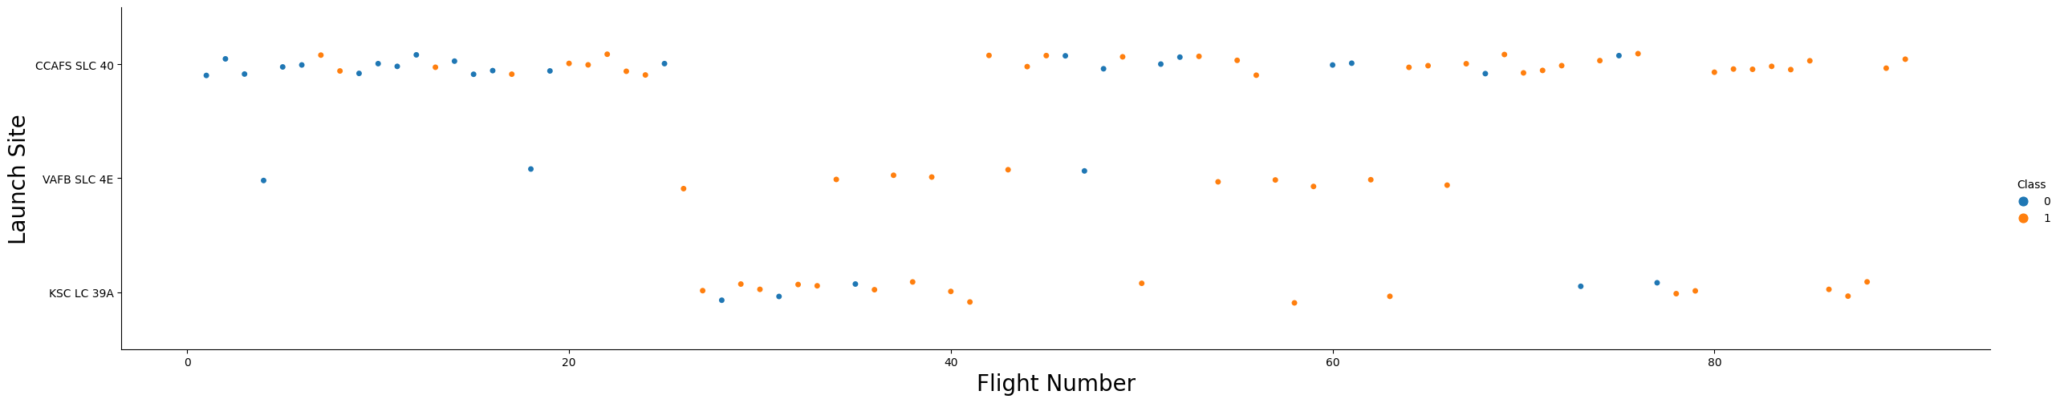
Flight Number vs. Launch Site
According to the plot above, it’s possible to verify that the best launch site, nowadays is CCAF5 SLC 40, where most of recent launches were successful
In second place VAFB SLC 4E and third place KSC LC 39A
It’s also possible to see that the general success rate improved over time.

Slide 22
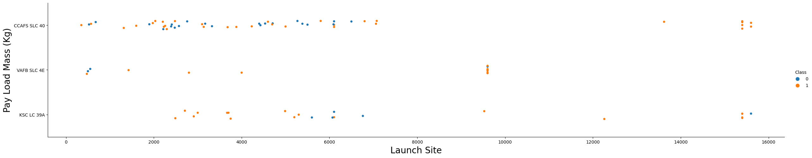
Payload vs. Launch Site
Payloads over 9,000kg (about the weight of a school bus) have excellent success rate;
Payloads over 12,000kg seems to be possible only on CCAFS SLC 40 and KSC LC 39A launch sites.

Slide 23
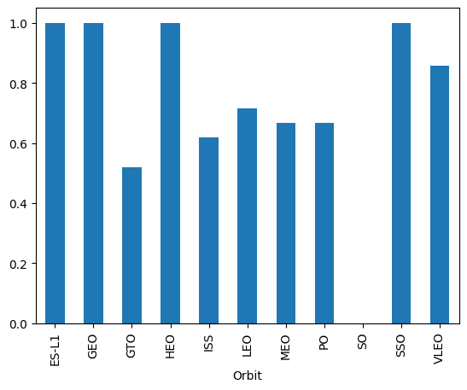
Success Rate vs. Orbit Type
The biggest success rates happens to orbits:
ES L1;
GEO;
HEO; and
SSO.

Slide 24
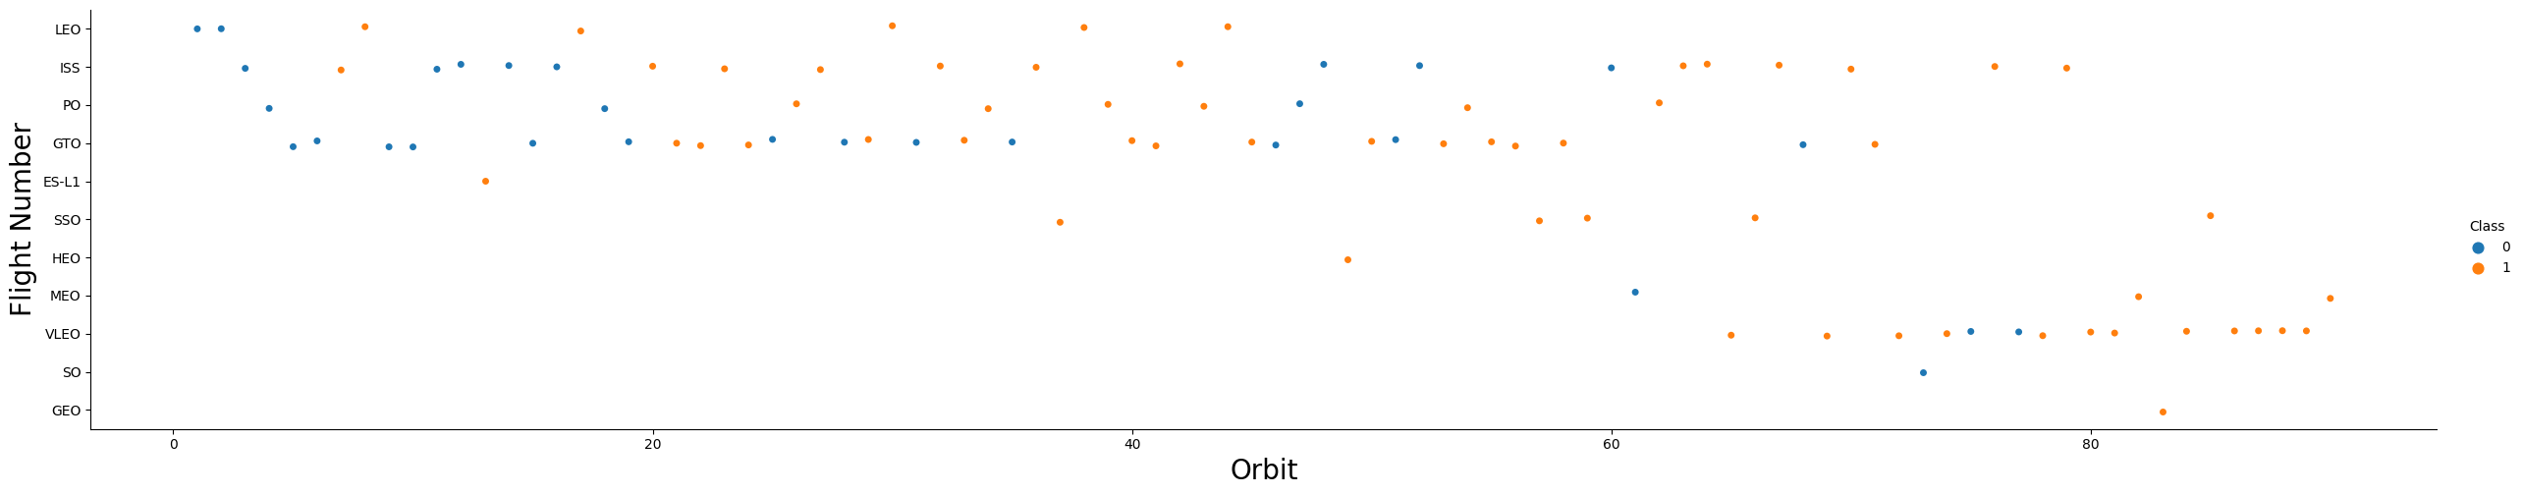
Flight Number vs. Orbit Type
Apparently, success rate improved over time to all orbits;
VLEO orbit seems a new business opportunity, due to recent increase of its frequency.

Slide 25
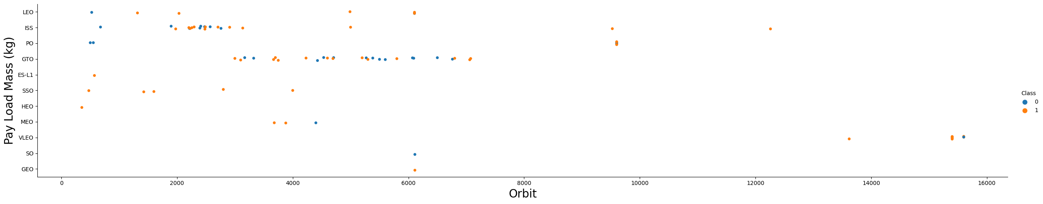
Payload vs. Orbit Type
Apparently, there is no relation between payload and success rate to orbit GTO;
ISS orbit has the widest range of payload and a good rate of success;
There are few launches to the orbits SO and GEO.

Slide 26
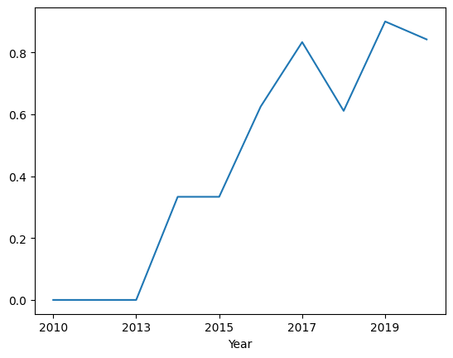
Launch Success Yearly Trend
Success rate started increasing in 2013 and kept until 2020
It seems that the first three years were a period of adjusts and improvement of technology.

Slide 27
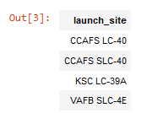
All Launch Site Names
According to data, there are four launch sites

Slide 28
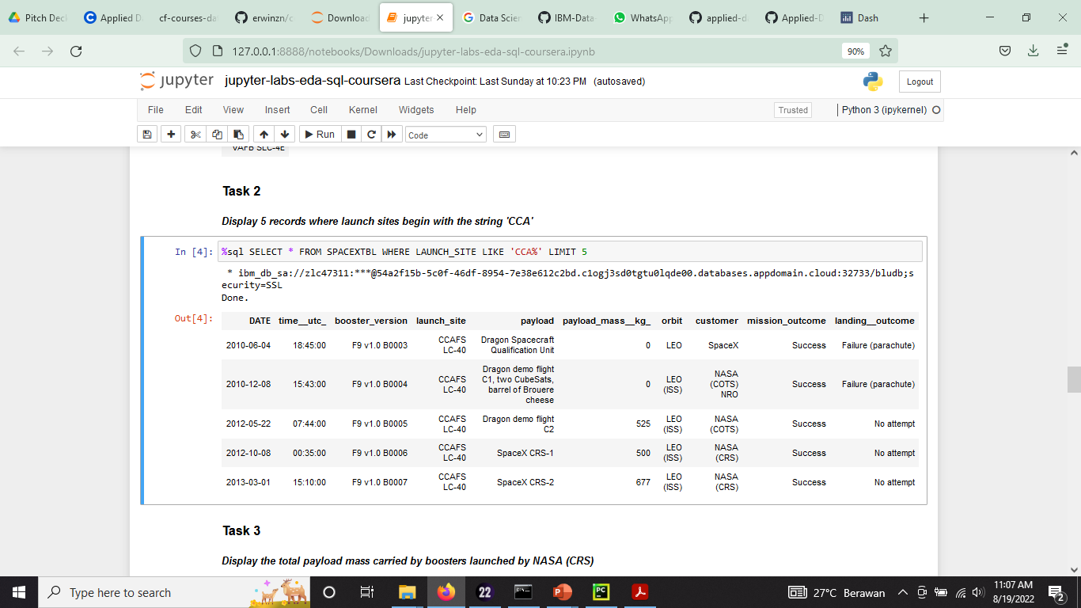
Launch Site Names Begin with 'CCA'
Here we can see five samples of Cape Canaveral launches.

Slide 29
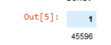
Total Payload Mass
Total payload calculated above, by summing all payloads whose codes contain ‘ CRS’, which corresponds to NASA.

Slide 30
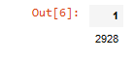
Average Payload Mass by F9 v1.1
Filtering data by the booster version above and calculating the average payload mass we obtained the value of 2,928 kg.

Slide 31
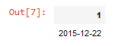
First Successful Ground Landing Date
By using the min function we can get the first date of successful landing outcome in ground pad was achieved

Slide 32
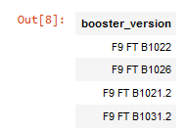
Successful Drone Ship Landing with Payload between 4000 and 6000
There are 5 boosters which have success in drone ship and have payload mass greater than 4000 but less than 6000

Slide 33
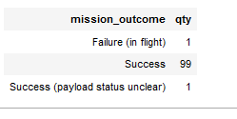
Total Number of Successful and Failure Mission Outcomes
There are 99 success mission outcome and 1 success but with payload status unclear and 1 failure mission_outcome

Slide 34
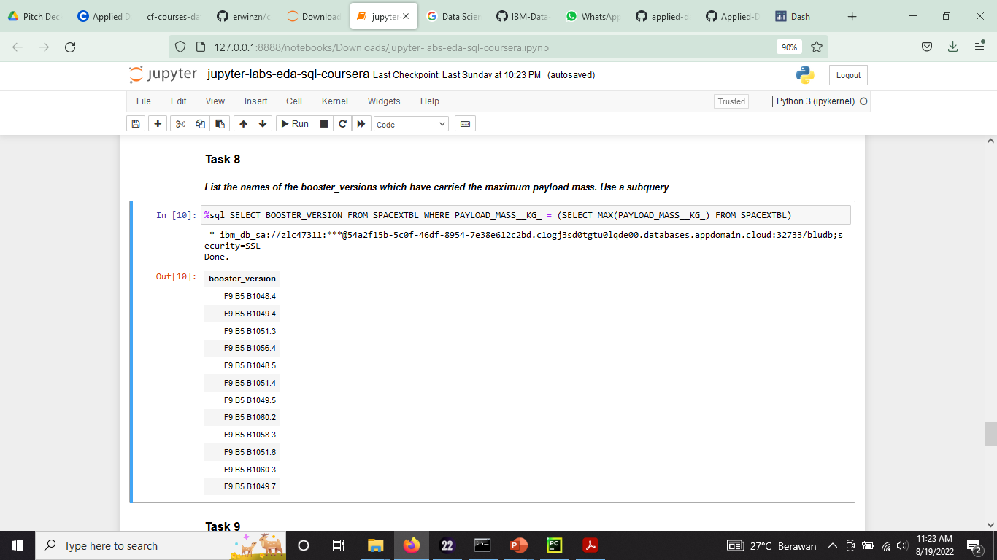
Boosters Carried Maximum Payload
There are 12 booster versions which have carried the maximum payload mass

Slide 35
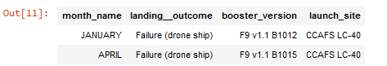
2015 Launch Records
There are 2 failed landing outcomes in 2015, the first in January with Booster Version F9 v1.1 B1012, and the second in April with Booster version F9 v1.1B1015, bot are launch in CCAFS LC-40 launch site

Slide 36
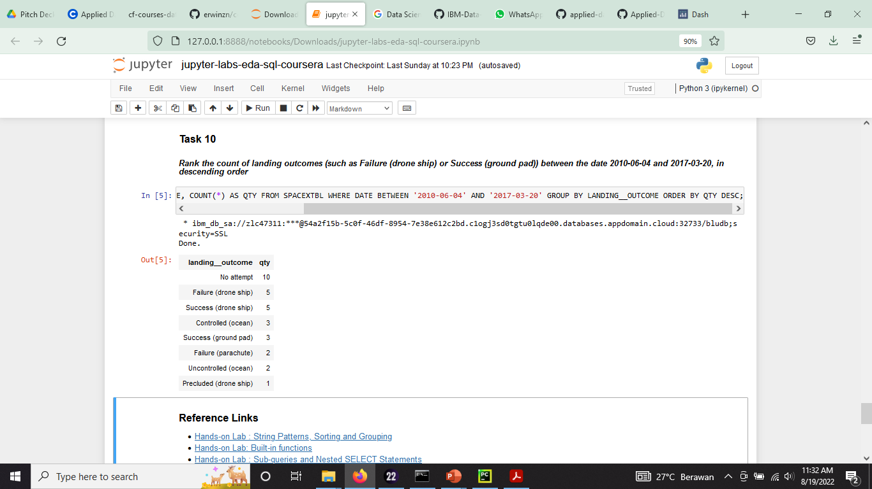
Rank Landing Outcomes Between 2010-06-04 and 2017-03-20
Ranking of all landing outcomes between the date 2010-06-04 and 2017-03-20:

Slide 37

Section 3

Slide 38
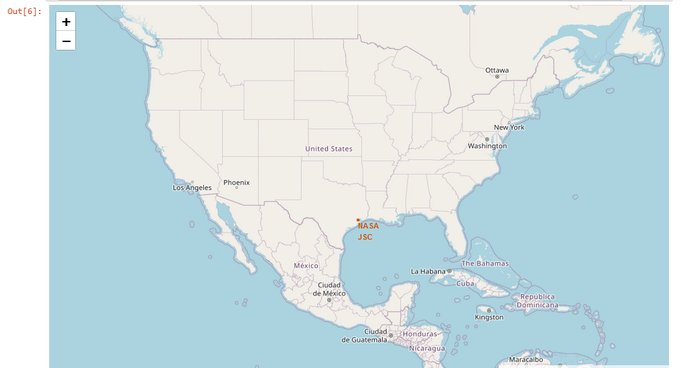
Launch Sites
Nasa Launch site

Slide 39
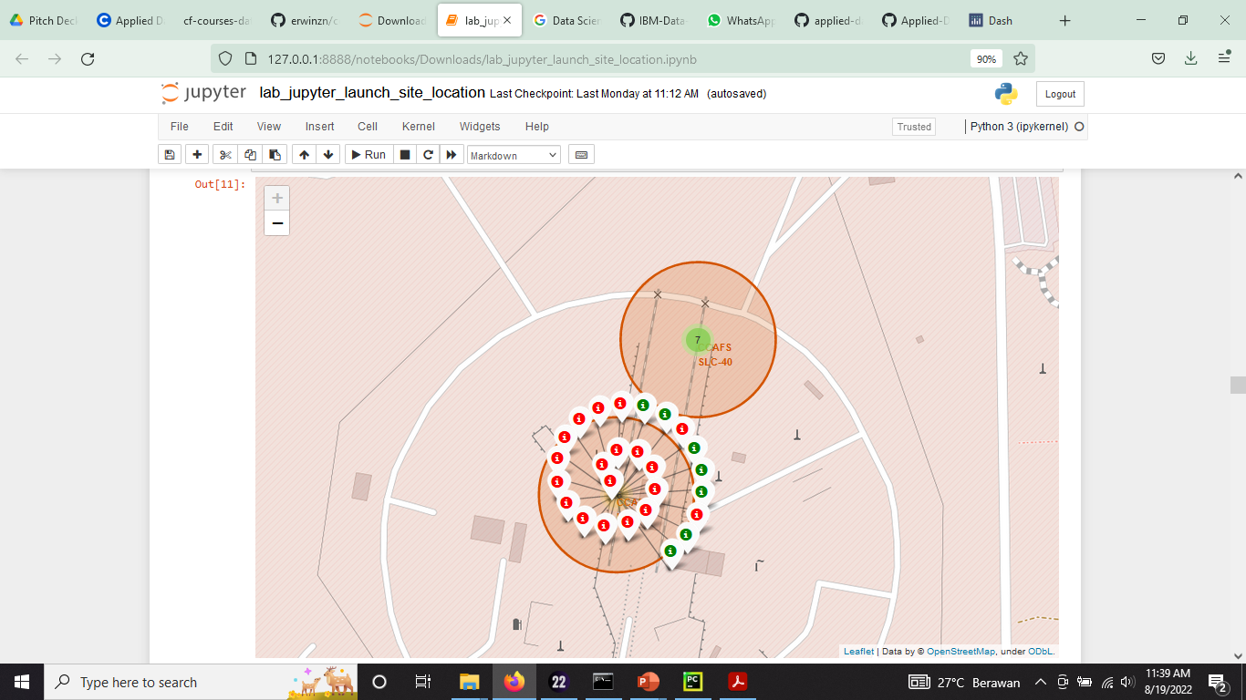
The success/failed launches for each site on the map
This is the marker for each success/failed launches, with green mean a success launch and red the failed one

Slide 40
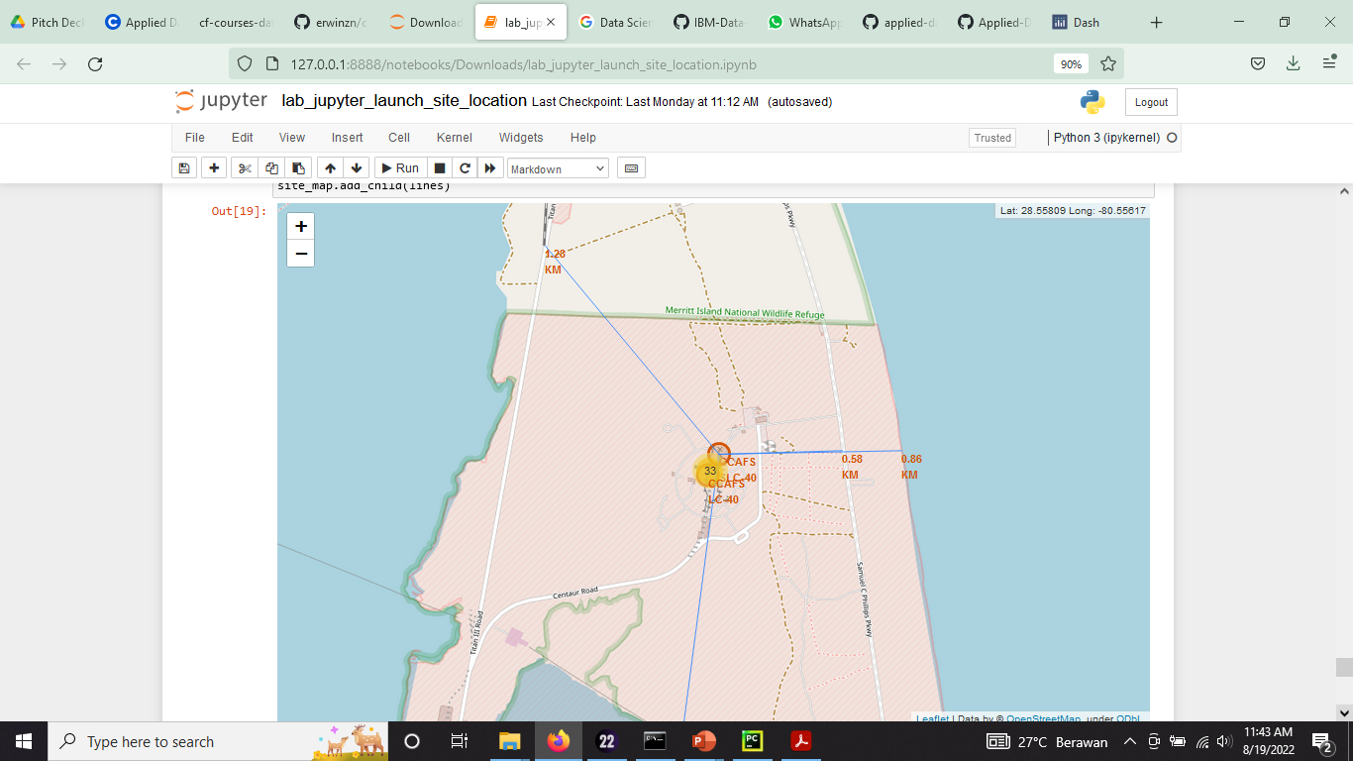
Launch site range
This map show how far the launch site to the public service

Slide 41

Section 4

Slide 42
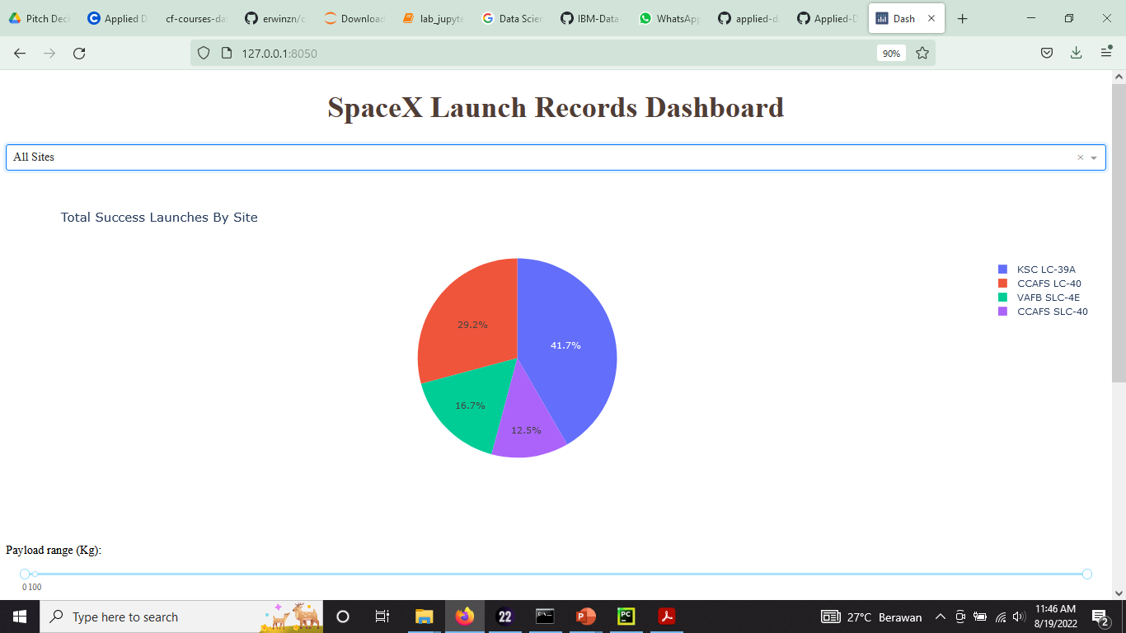
Total Success Launch By Site
From this chart we can see that the KSC LC 39A has a higher success rate than the other launch sites

Slide 43
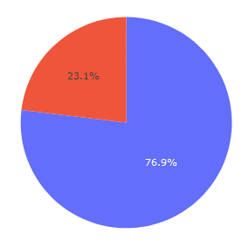
KSC LC-39A Success ratio
KSC LC-39A has the higher success ration than other launch sites, it has 76.9% success rate

Slide 44
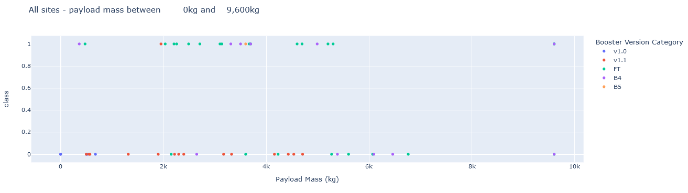
Scatter Plot Payload Mass vs Launch Outcomes
Payloads under 9.600kg have FT Booster version most success

Slide 45
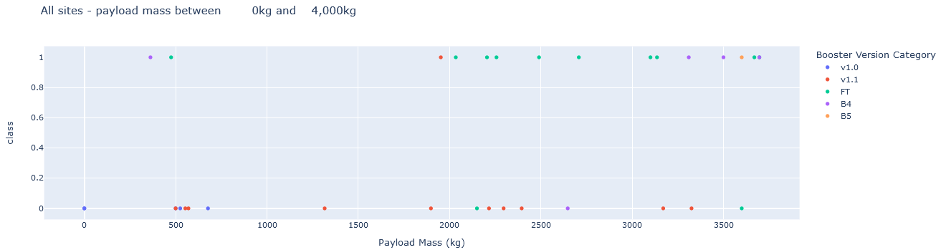
Scatter Plot Payload Mass vs Launch Outcomes
Payloads under 4.000kg have FT Booster version most success

Slide 46

Section 5

Slide 47
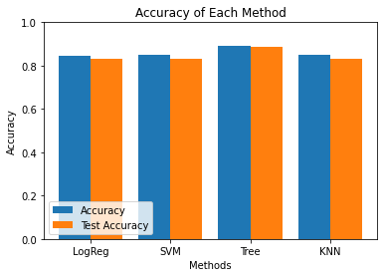
Classification Accuracy
We are using four model, and the testaccuracy has been plot to the Bar Chart
From the Bar Chart, we can see that Decision Tree Model has higher accuracy

Slide 48
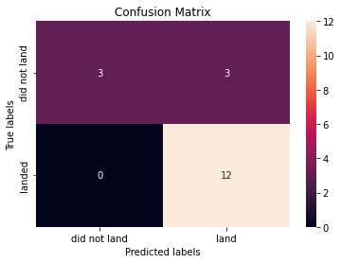
Confusion Matrix
The best performing model is the decision tree model
Confusion matrix of Decision Tree Classifier proves its accuracy by showing the bignumbers of true positive and true negative compared to the false ones.

Slide 49
Conclusions
Different data sources were analyzed, refining conclusions along the process;
The best launch site is KSC LC 39A;
Launches above 7,000kg are less risky;
Although most of mission outcomes are successful, successful landing outcomes seem to improve over time, according the evolution of processes and rockets;
Decision Tree Classifier can be used to predict successful landings and increase profits.

Slide 50
Appendix
Folium didn’t show maps on Github, the screenshot is on github

Slide 51


